Slide 1

Forecasting the Future of Crop Yields By Data Analysis
Predicting the next crop yield success
SAURABH JAMNARE

Slide 2
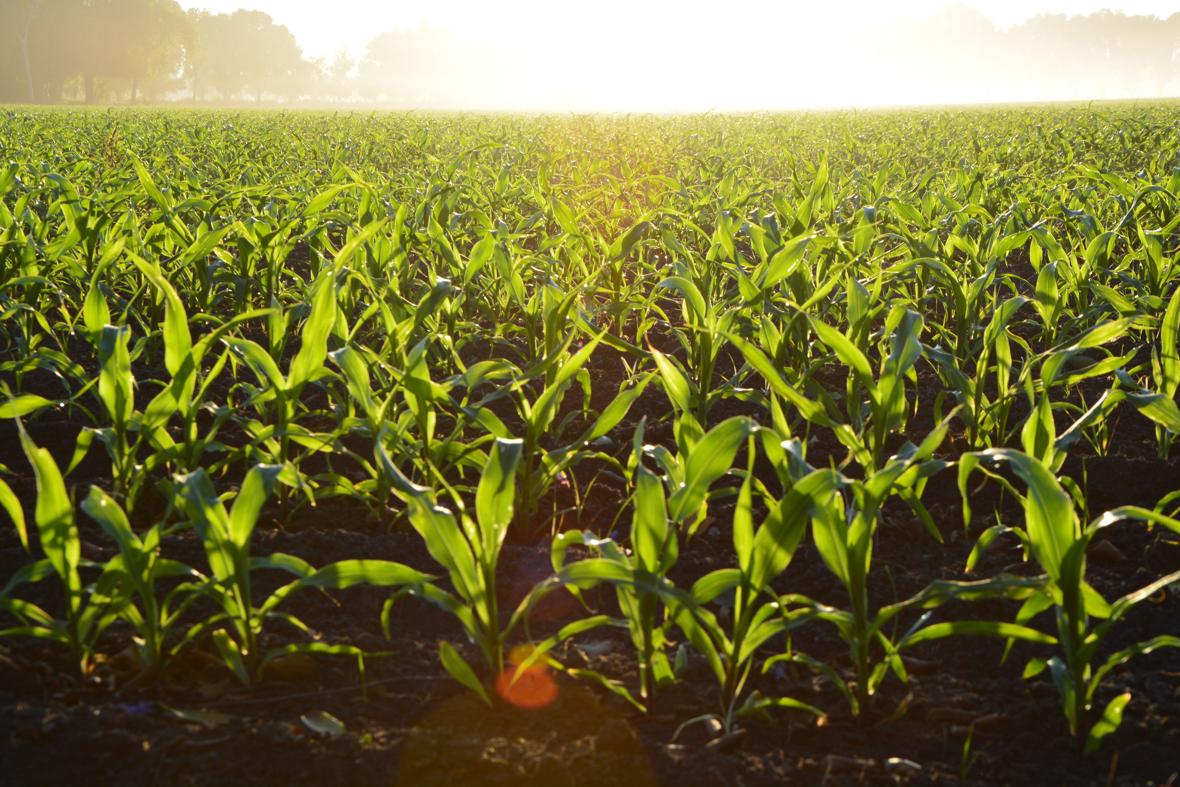
Crop Yield Forecast
Analyzing historical data and weather patterns to predict crop yields accurately this season.

Slide 3
Weather Forecast Analysis
Analyze past data to predict future crop yields accurately.
Pesticide Impact
Understanding pesticides usage crucial for determining crop yield potential.
Yield analysis
Utilize data for precise crop monitoring and management.

Slide 4
Predicting Crop Yields
Crop yield prediction is a crucial element in agricultural planning and decision-making processes.

Slide 5
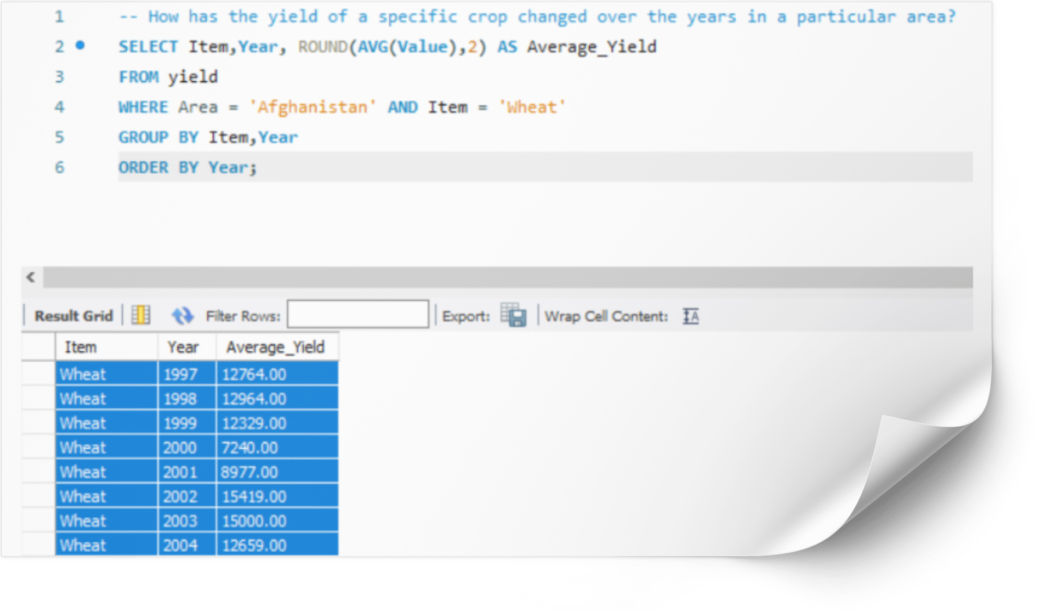
Yield Change Over Years:
The average yield of wheat in the specified area has fluctuated over the years. It's seen both increases and decreases, with notable spikes in certain years like 2002 and 2003.
Predict that wheat yield will continue to fluctuate based on historical patterns, influenced by various factors such as weather conditions, technological advancements, and agricultural practices.

Slide 6
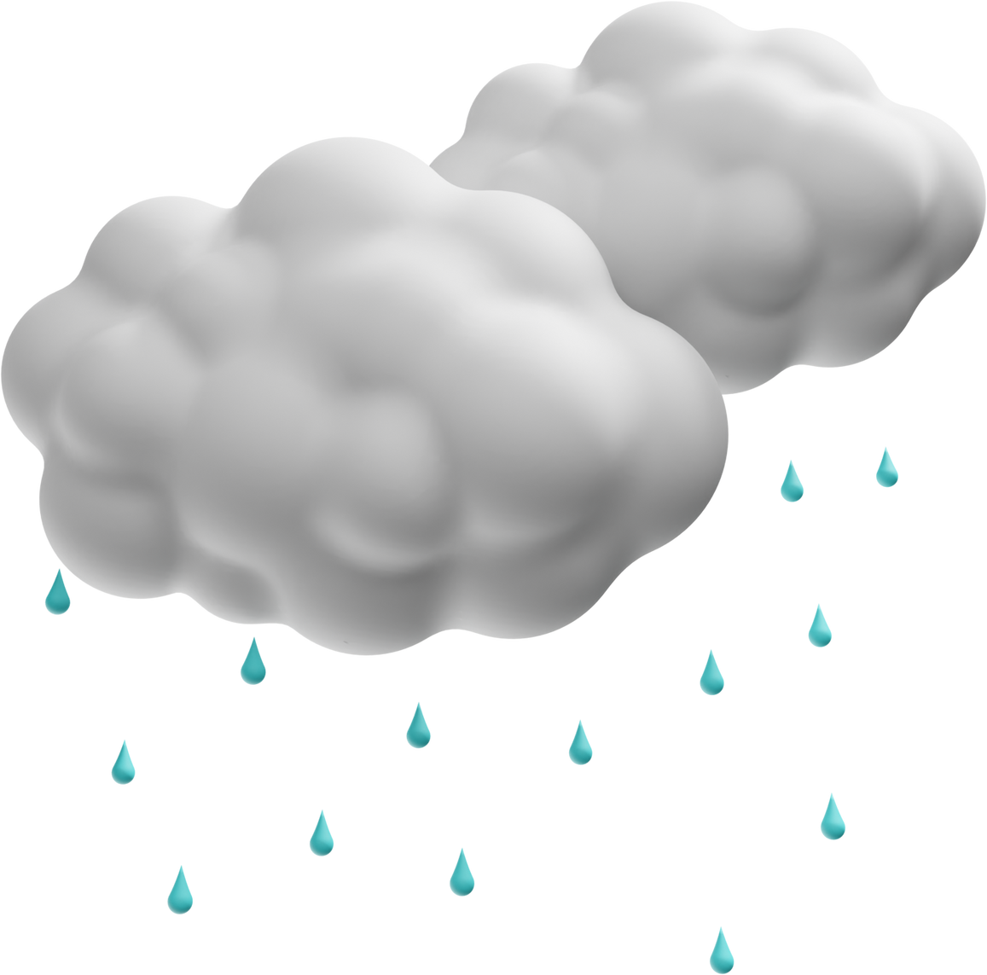
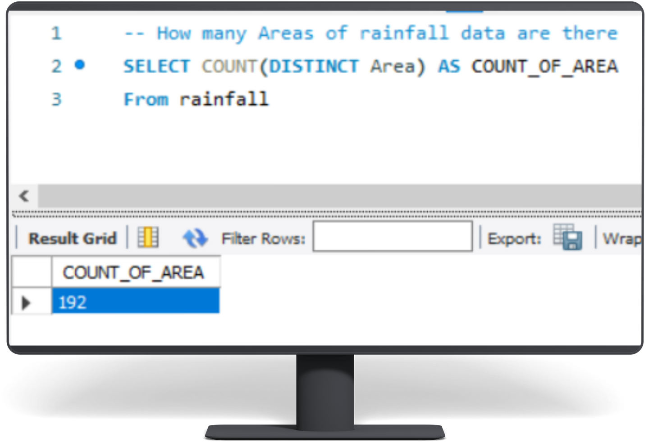

Areas of Rainfall Data:
There are 192 areas for which rainfall data is available

Slide 7

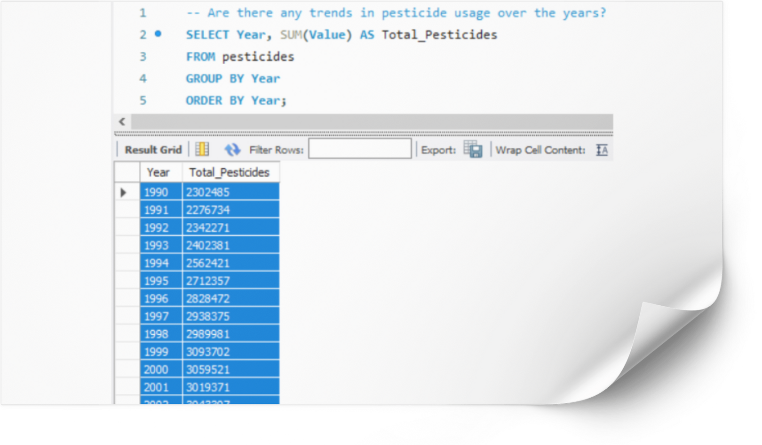
Trends in Pesticide Usage:
Pesticide usage has generally increased over the years, with occasional fluctuations but a noticeable upward trend from 1990 to 2016.
Predict a continued upward trend in pesticide usage due to increasing demand for food production, although there may be periodic fluctuations based on regulatory changes and advancements in pest management techniques

Slide 8

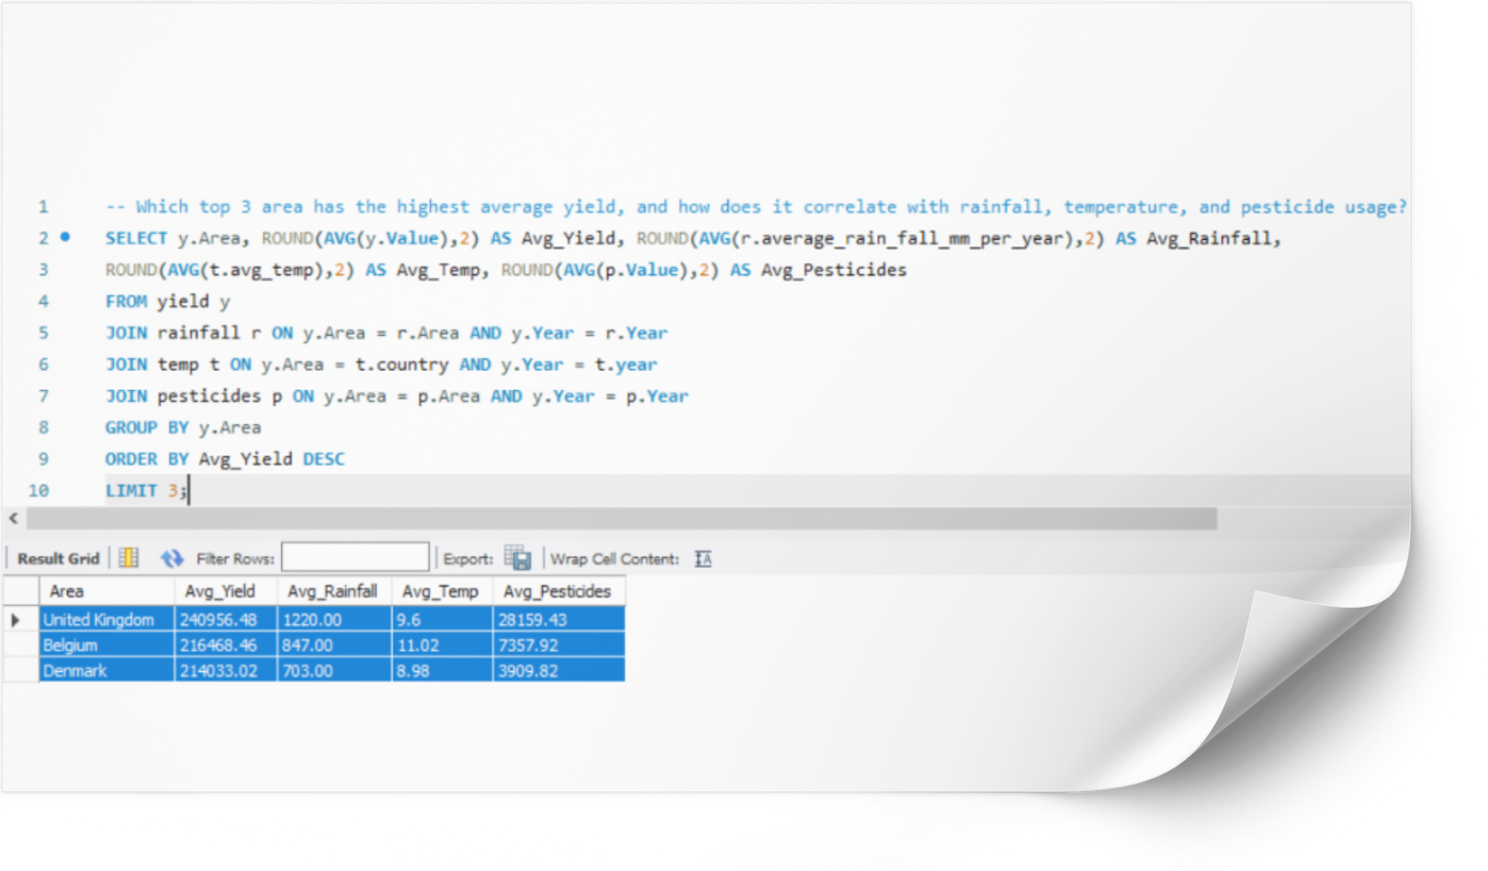
Top 3 Areas with Highest Average Yield and Correlation:
United Kingdom, Belgium, and Denmark are the top 3 areas with the highest average yield. The correlation between yield and factors like rainfall, temperature, and pesticide usage varies across these areas.
The top areas with the highest average yield may change over time as agricultural practices evolve, and the correlation between yield and environmental factors will continue to be studied for optimization.

Slide 9
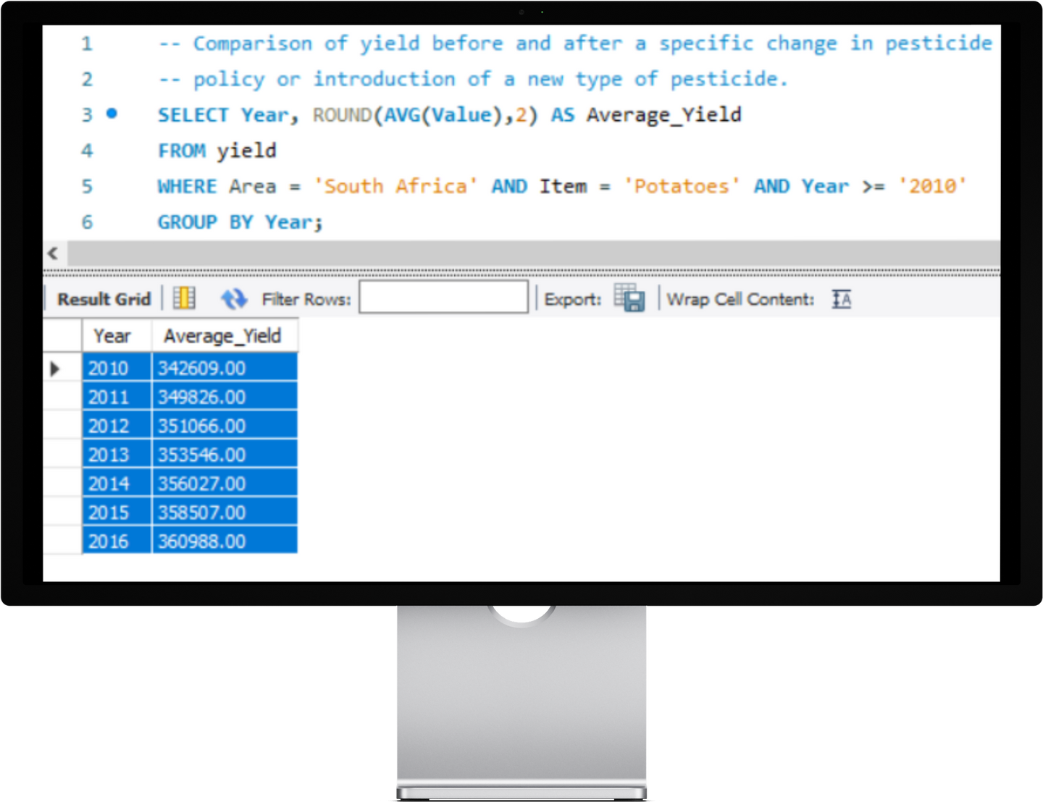

Comparison of Yield Before and After Pesticide Policy Change:
The average yield has generally increased from 2010 to 2016, possibly indicating a positive impact from a change in pesticide policy or introduction of new pesticides.
Yield improvements seen after a pesticide policy change will continue if the new policies promote sustainable and effective pest management practices.

Slide 10



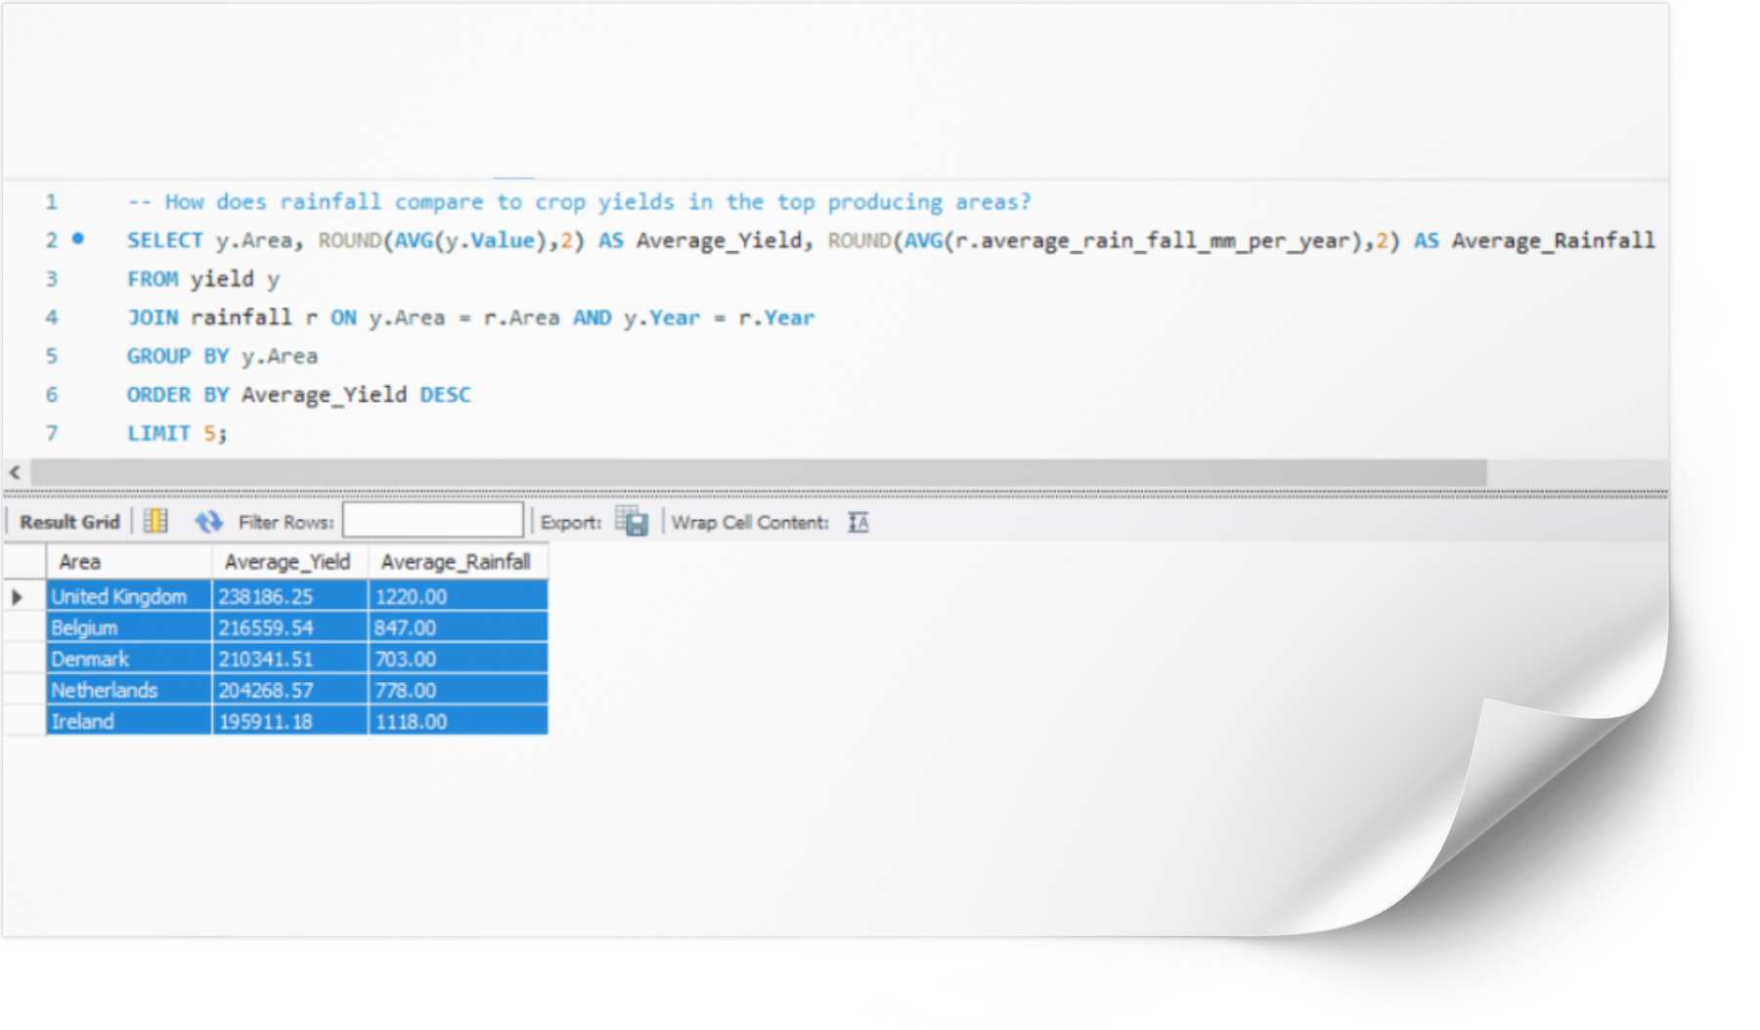
Rainfall vs. Crop Yields in Top Producing Areas:
United Kindom, Belgium, Denmark, Netherland, Ireland having average yields across top producing areas, and their correlation with avergae rainfall.
The relationship between rainfall and crop yields will continue to be studied and optimized, with technology playing a crucial role in precision farming and water management.

Slide 11
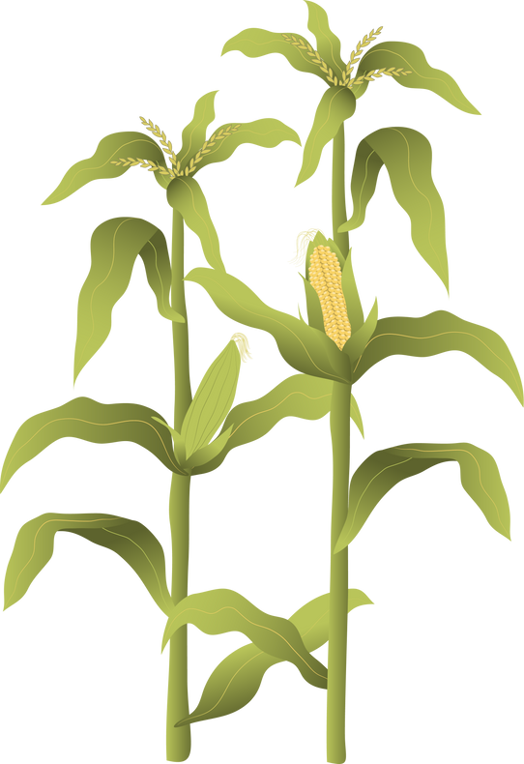
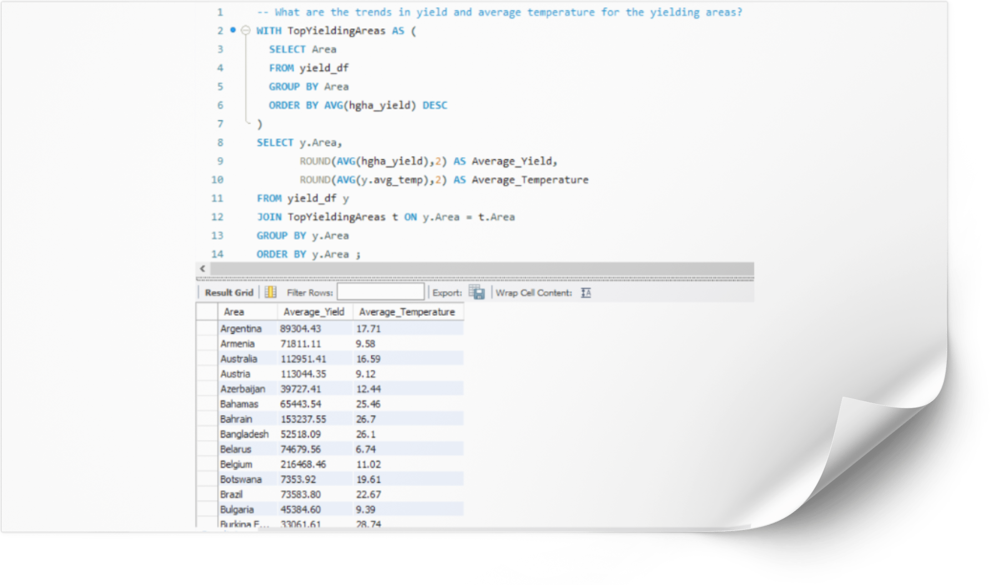
The trends indicate a complex relationship between average yield and average temperature, influenced by various factors including technological advancement, agricultural practices, and geographical conditions.
Regions with temperate climates tend to have higher yields, while those with extreme temperatures (either very high or very low) tend to have lower yields.

Slide 12

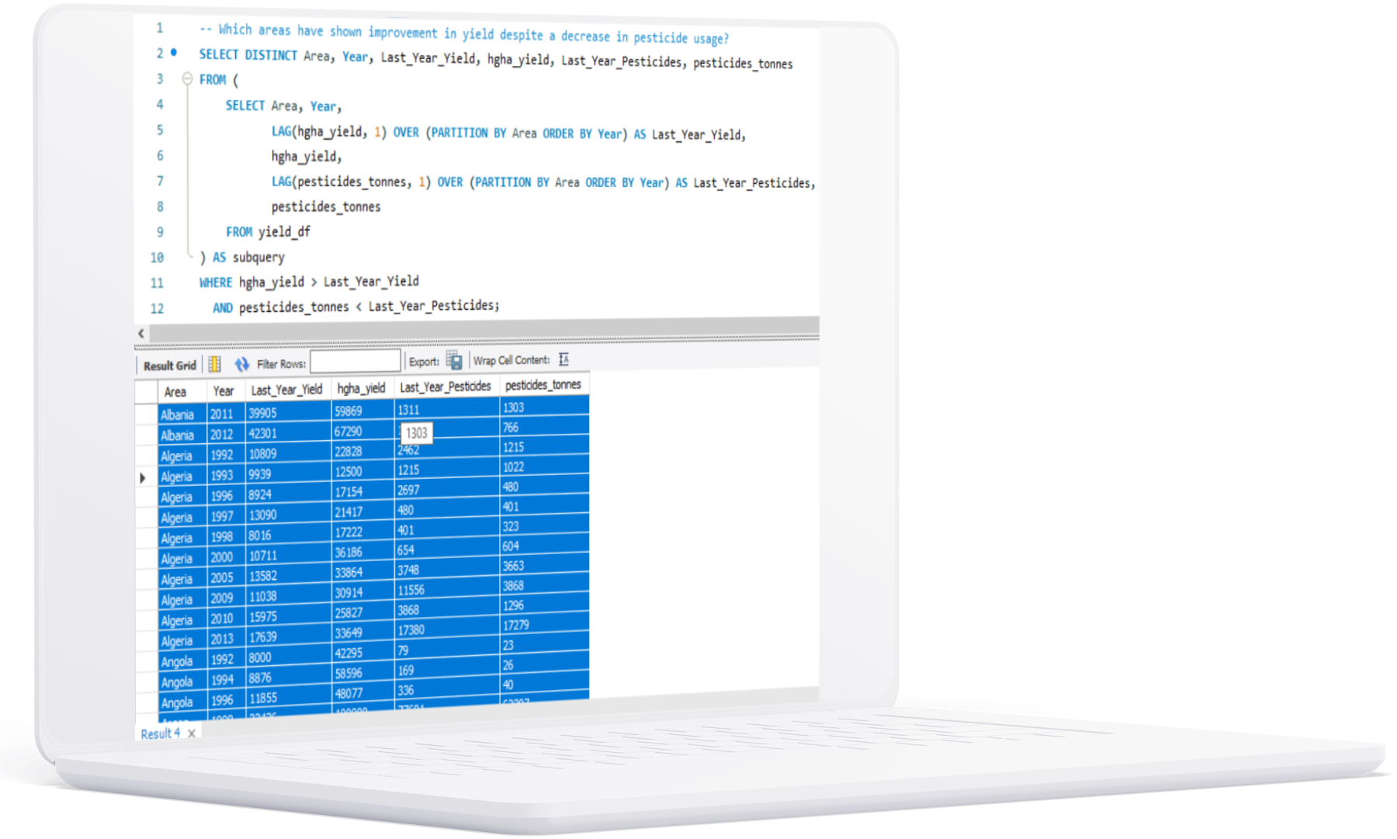



Several countries have shown notable improvements in agricultural yields while simultaneously reducing pesticide usage for Example Albania, Columbia Etc.
Albania:
From 2011 to 2012, the yield increased from 39,905 to 42,301 hgha, while pesticide usage dropped from 1,311 to 766 tonnes.
Colombia:
Between 2007 and 2010, Colombia’s yield increased from 108,337 to 106,094 hgha, while pesticide usage significantly dropped from 98,329 to 48,618 tonnes.

Slide 13

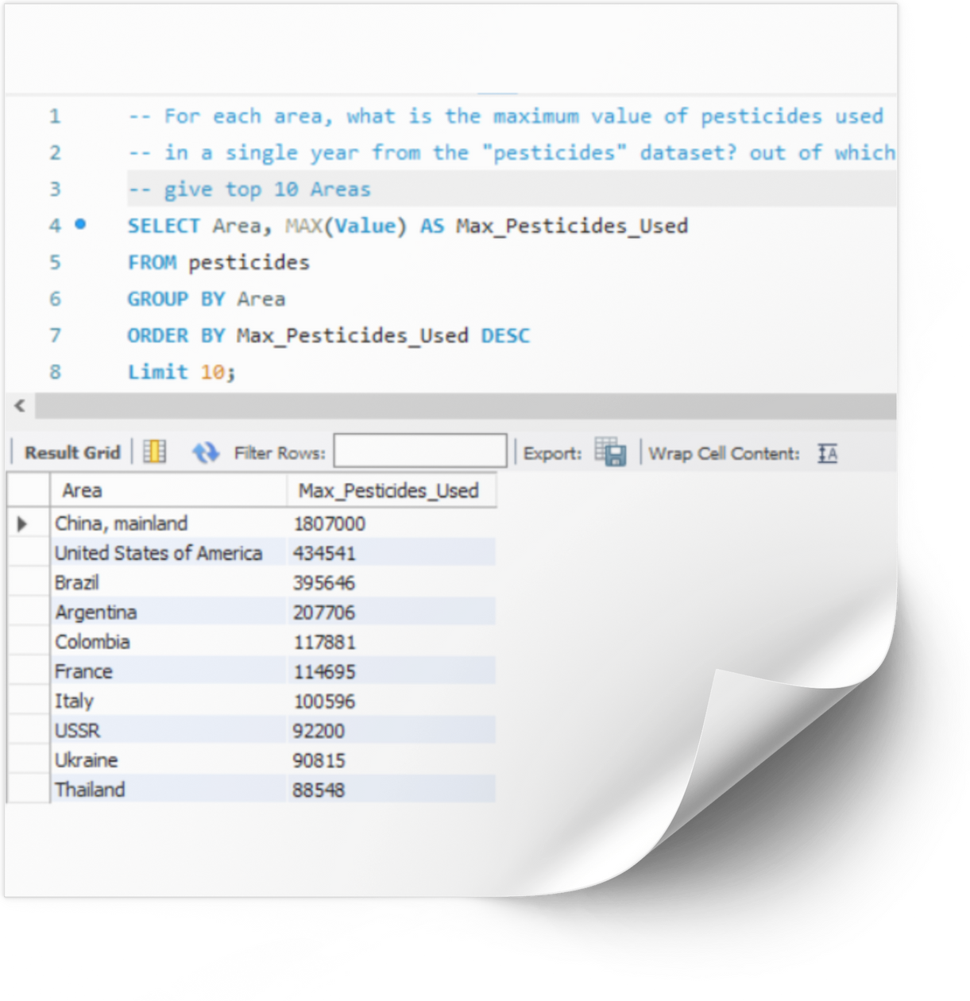
The data reflects global agricultural practices with high pesticide usage concentrated in major agricultural economies, including countries in North and South America, Europe, and Asia.
Developed vs. Developing Countries:
Both developed (e.g., United States, France, Italy) and developing countries (e.g., China, Brazil, Colombia) exhibit high pesticide usage, indicating a widespread reliance on pesticides in agriculture irrespective of the country's development status.
Environmental and Health Implications: The high levels of pesticide use in these regions may have significant implications for environmental health and safety, necessitating ongoing monitoring and potential regulation to mitigate adverse effects.

Slide 14



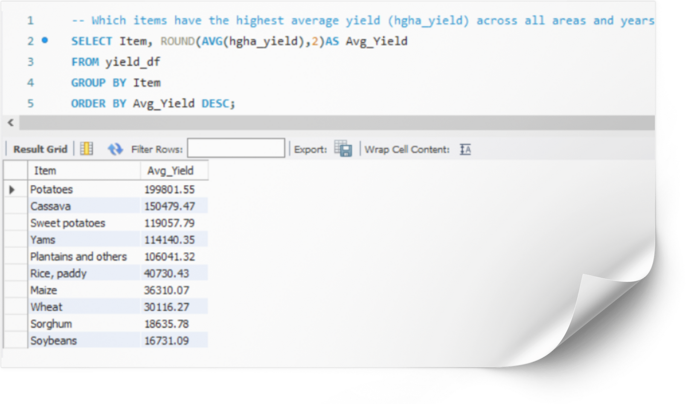

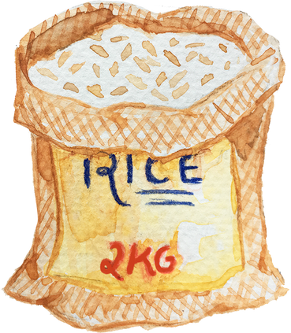
Highest Average Yield Across All Areas and Years (Top 10):
The top crops in terms of average yield across all areas and years are potatoes, cassava, sweet potatoes, yams, and others.
crops with consistently high average yields will continue to be prioritized in agricultural production, with ongoing research and development to further enhance their productivity.

Slide 15


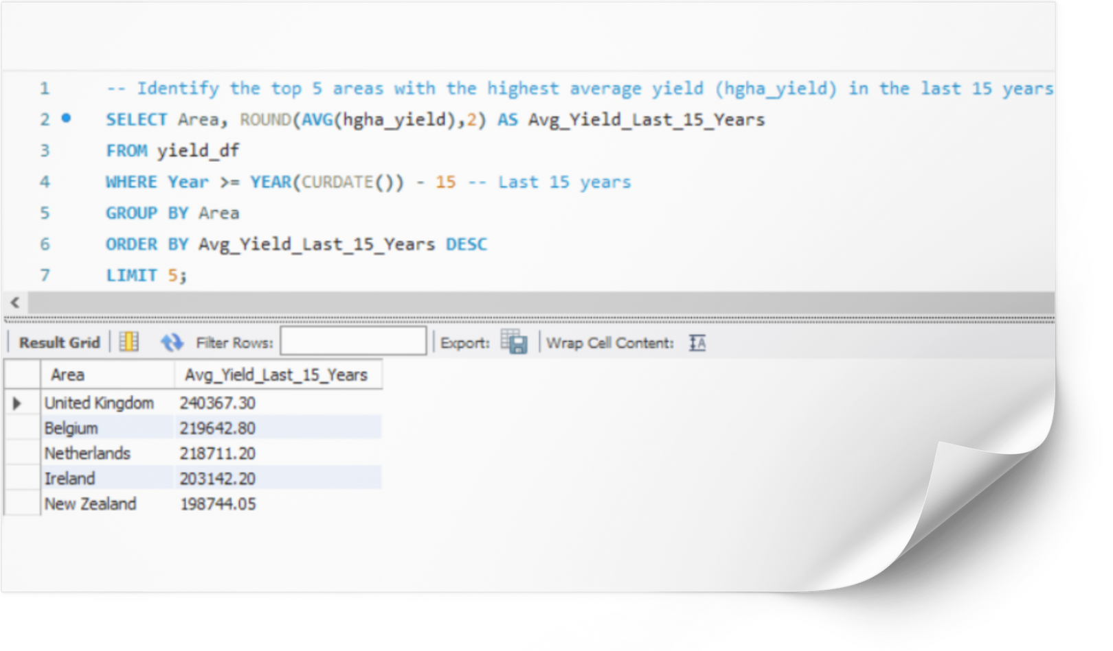
Top 5 Areas with Highest Average Yield in Last 15 Years:
United Kingdom, Belgium, Netherlands, Ireland, and New Zealand are the top areas with high average yields over the last 15 years.
areas with historically high average yields will continue to innovate and invest in agricultural technologies to sustain and improve productivity.

Slide 16

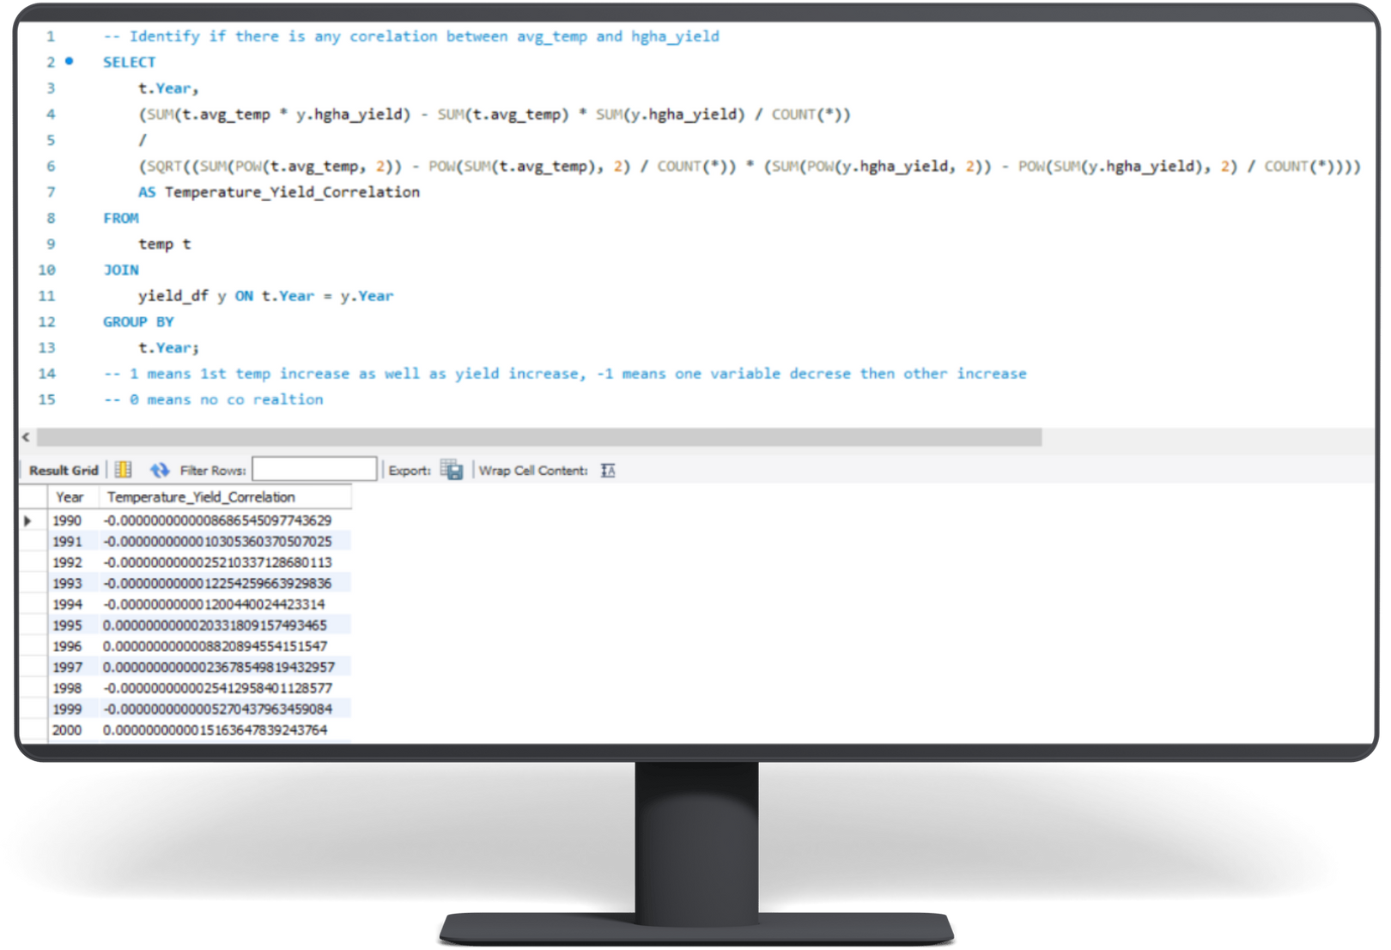

Correlation Between Average Temperature and Yield:
The correlation between average temperature and yield fluctuates over the years, with some years showing positive correlations and others negative.
The data indicates an extremely weak and insignificant correlation between average temperature and hgha_yield over the years. This suggests that average temperature alone is not a reliable predictor of crop yield, and other factors should be given more attention in efforts to optimize agricultural output.

Slide 17
Thank
you!

